Slide 1

Mentorness Project 1
Decode Gaming Behavior
By: Sahil Kakadiya

Slide 2
Contents
Objective
Queries
Conclusion

Slide 3
Objective
Utilize SQL to extract insights from ‘Player Details’ and ‘Level Details’ on player engagement and performance metrics.
Provide actionable insights for game design optimization based on analysis of 15 specific query responses.
Enhance skills in SQL and data analytics through advanced query techniques and data interpretation.

Slide 4
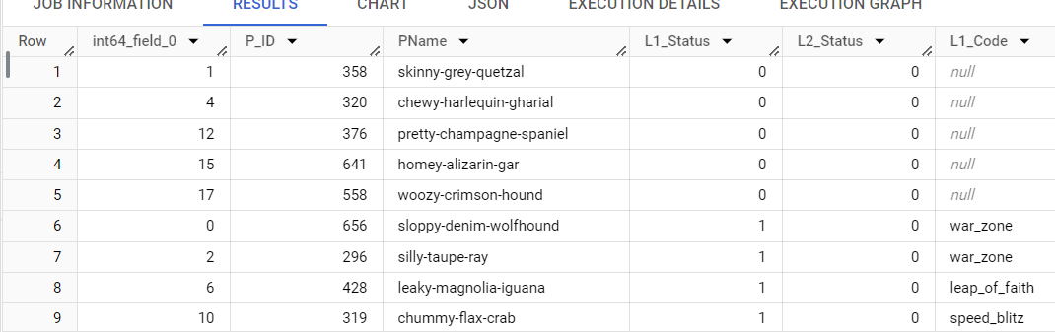
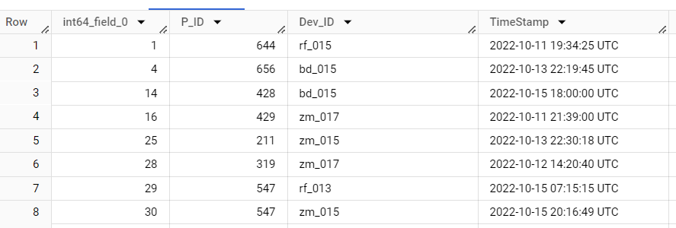
Datasets
I mentioned here our dataset Images from both tables
Query: select * from level_details
select * from player_details

Slide 5
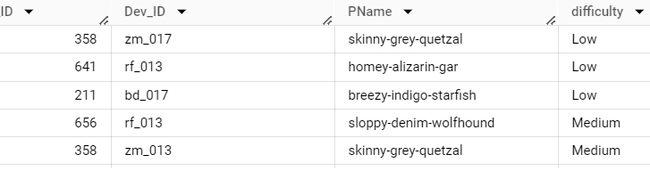
Q1: Extract ‘P_ID’, ‘Dev_ID’, ‘PName’, and ‘Difficulty_level’ of all players at Level 0
select P_ID, Dev_ID, PName, difficulty from ld left join pd on pd.P_ID = ld.P_ID where ld.level = 0;

Slide 6
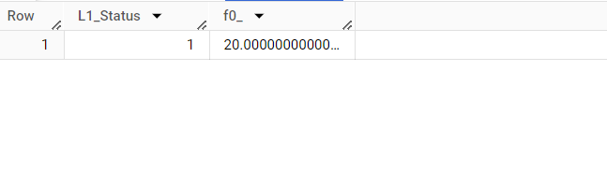
Q2: Find `Level1_code`wise average `Kill_Count` where `lives_earned` is 2, and at least 3 stages are crossed
select pd.L1_Status,avg(Kill_Count) from ld left join pd on pd.P_ID = ld.P_ID where ld.Lives_Earned = 2 and ld.Stages_Crossed>=3 group by pd.L1_Status;

Slide 7
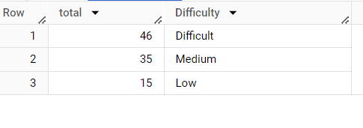
Q3: Find the total number of stages crossed at each difficulty level for Level 2 with players using `zm_series` devices. Arrange the result in decreasing order of the total number of stages crossed.
select sum(Stages_crossed) as `total`, Difficulty from ld left join pd on pd.P_ID = ld.P_IDwhere ld.Dev_ID like "zm%" and ld.Level = 2 group by ld.Difficulty order by `total` desc;

Slide 8
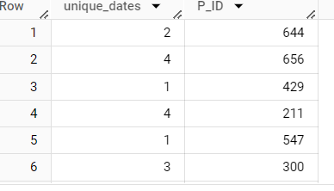
Q4: Extract `P_ID` and the total number of unique dates for those players who have played games on multiple days.
SELECT count(DISTINCT(DATE(TimeStamp))) as unique_dates, P_ID FROM ld group by P_ID having count(distinct(TimeStamp))>1;

Slide 9
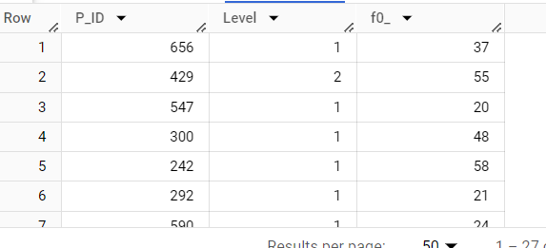
Q5: Find `P_ID` and levelwise sum of `kill_counts` where `kill_count` is greater than the average kill count for Medium difficulty.
SELECT P_ID, Level, sum(Kill_Count) FROM ld where Kill_Count> (select avg(Kill_Count) from ld where Difficulty="Medium") group by P_ID, Level;

Slide 10
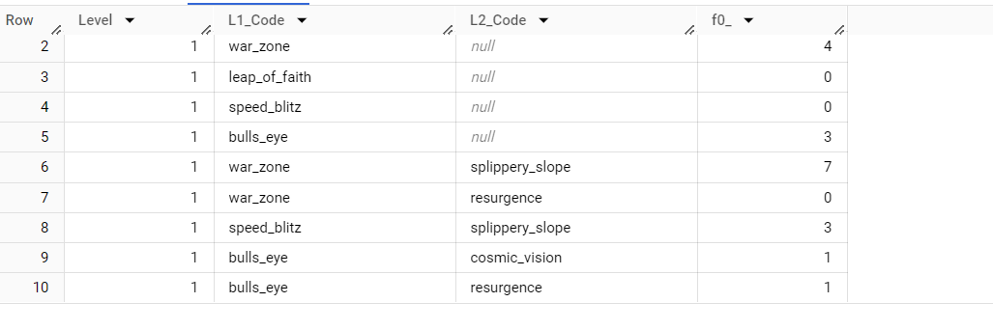
Q6: Find `Level` and its corresponding `Level_code`wise sum of lives earned, excluding Level 0. Arrange in ascending order of level.
SELECT ld.Level, pd.L1_Code, pd.L2_Code, sum(ld.Lives_Earned) FROM ld join pd on ld.P_ID = pd.P_ID where ld.Level!= 0 group by ld.Level, pd.L1_Code, pd.L2_Code order by ld.Level;

Slide 11
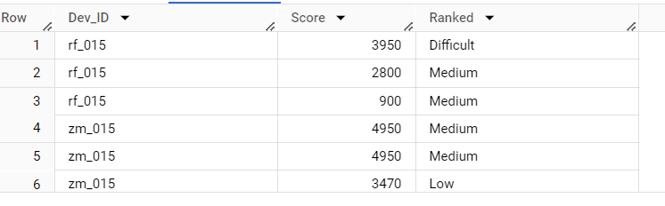
Q7: Find the top 3 scores based on each `Dev_ID` and rank them in increasing order using `Row_Number`. Display the difficulty as well.
with new_table as ( select Dev_ID, Difficulty, Score, row_number() over (partition by Dev_ID order by Score desc) as Ranked from ld) select Dev_ID, Score, Difficulty Ranked from new_table where Ranked <= 3;

Slide 12
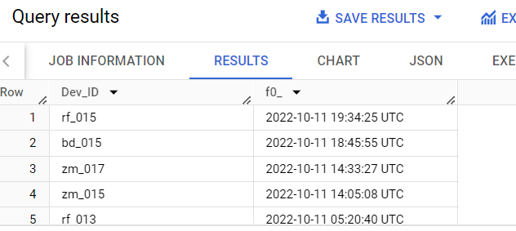
Q8: Find the `first_login` datetime for each device ID.
select Dev_ID, min(TimeStamp)from ld group by Dev_ID;

Slide 13
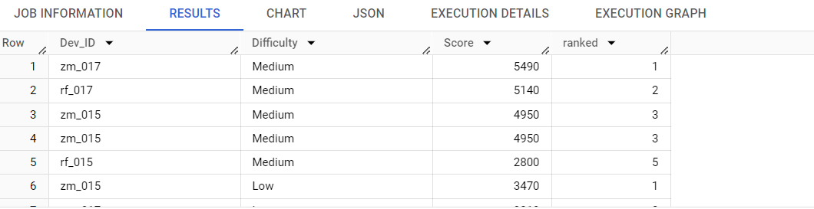
Q9: Find the top 5 scores based on each difficulty level and rank them in increasing order using `Rank`. Display `Dev_ID` as well.
with new_table as ( select Dev_ID, Score, Difficulty, rank() over (partition by Difficulty order by Score desc) as ranked from ld )select Dev_ID, Difficulty, Score, ranked from new_table where Ranked < 6;

Slide 14
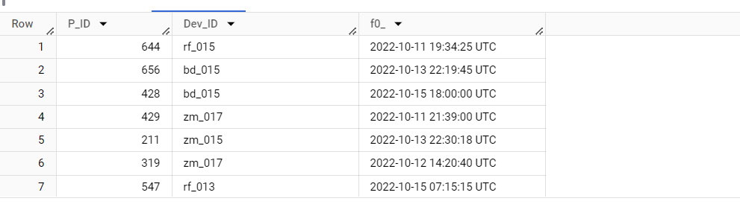
Q10: Find the device ID that is first logged in (based on `start_datetime`) for each player (`P_ID`). Output should contain player ID, device ID, and first login datetime.
selectP_ID, Dev_ID, min(TimeStamp) from ld group by Dev_ID, P_ID;

Slide 15
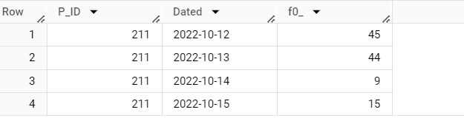
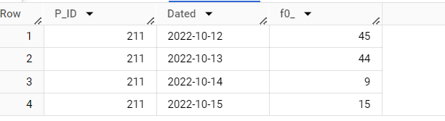
Q11: For each player and date, determine how many `kill_counts` were played by the player so far. a) Using window functions b) Without window functions
A) select distinct P_ID, cast(TimeStamp as Date) as Dated, sum(Kill_Count) over (partition by P_ID, cast (TimeStamp as Date) order by Cast(TimeStamp as Date)) from ld order by P_ID, Dated;
B) selectP_ID, cast(TimeStamp as Date) as Dated, sum(Kill_Count)fromldgroup byP_ID,Cast(TimeStamp as Date)order byP_ID, Dated;

Slide 16
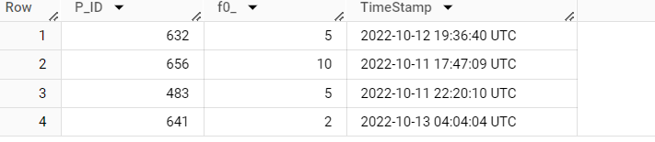
Q12: Find the cumulative sum of stages crossed over `start_datetime` for each `P_ID`, excluding the most recent `start_datetime`.
select pd.L1_Status,avg(Kill_Count) from ld left join pd on pd.P_ID = ld.P_ID where ld.Lives_Earned = 2 and ld.Stages_Crossed>=3 group by pd.L1_Status;

Slide 17
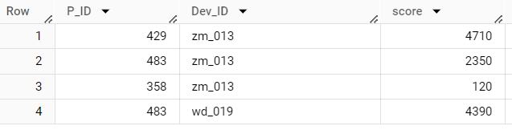
Q13: Extract the top 3 highest sums of scores for each `Dev_ID` and the corresponding `P_ID`
Select P_ID, Dev_ID, sum(Score) as score, row_number()over(partition by Dev_ID order by sum(Score) desc) as Ranked from ld group by Dev_ID, P_ID;
select Dev_ID, P_ID, score from task where Ranked<4;

Slide 18
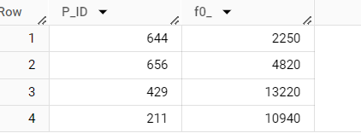
Q14: Find players who scored more than 50% of the average score, scored by the sum of scores for each `P_ID`
Select P_ID, sum(Score) from ld group by P_ID having sum(Score)>0.5 * ( select avg(Score) from ld );

Slide 19
Q15: Create a stored procedure to find the top `n` `headshots_count` based on each `Dev_ID` and rank them in increasing order using `Row_Number`. Display the difficulty as well
DELIMITER //CREATE procedure TopN(IN n INT)BEGIN select Dev_Id, Headshots_Count, Difficulty from ( select Dev_ID, Headshots_Count, Difficulty, row_number() over (partition by Dev_ID order by Headshots_Count) as ranked from ld ) as task where ranked <= n; End// DELIMITER ; call TopN(6)

Slide 20
Conclusion
Through detailed SQL analysis of the Player Details and Level Details tables, this internship has successfully decoded complex gaming behaviors, providing actionable insights for game enhancement and strategic player engagement.

